Slide 1

Artificial Neural Network
Multimodal Fake News Detection Using Text and Images
Presented to : Dr. Ensaf Hussein
Eng. Ahmed Gamal
Presented By:
Ahmed Hazem Hassan 221001099
Ahmed Hossam Abdelsalam 231001426
Amr Mohamed El-Hassaneen 221001520
Mohamed Ayoub Khabiry 221000728
01

Slide 2
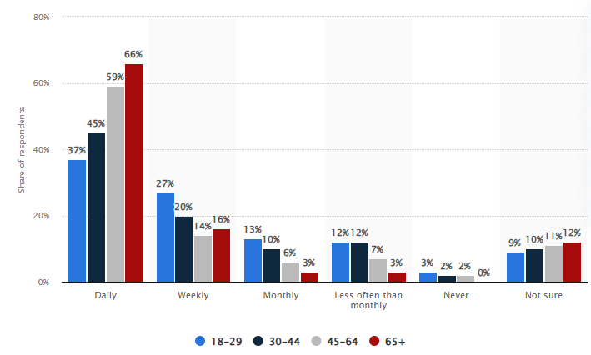
Fake News
Fake news is a growing concern, especially with the rise of social media platforms. Misleading information can influence public opinion, spread misinformation, and cause real-world harm.

Slide 3
Our DataSet
Content:
2 Sources:
GossipCop: Entertainment and celebrity news
PolitiFact: Political statements and fact-checks
Each source has:
1 - real news samples
2 - fake news samples
01
02
03

Slide 4
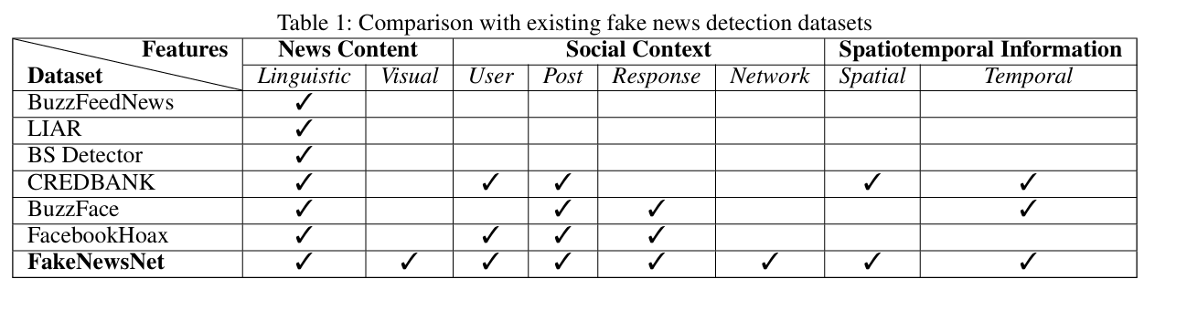
Data Acquisition
Dataset collection
03
We focused only on collecting News Content
03

Slide 5
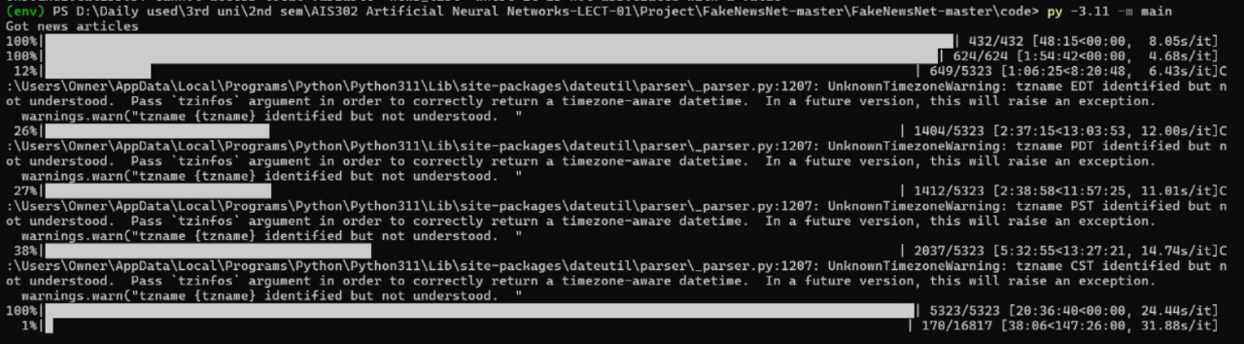
Data Acquisition
Dataset collection
Web scrapping Problems
Old Code with older version of libraries and python
Too long time (147 hr.)
Solutions
Creatred venv with isolated dependancies and downloaded older python v11
Updated the code to become faster [Total time taken about 1hr.]
03

Slide 6
Text Visualization
Real vs Fake Article Distribution
Compared the number of real vs fake news articles in each dataset
Used:
Pie charts to show percentage
Frequent Words in Fake vs Real News
01
02
03

Slide 7
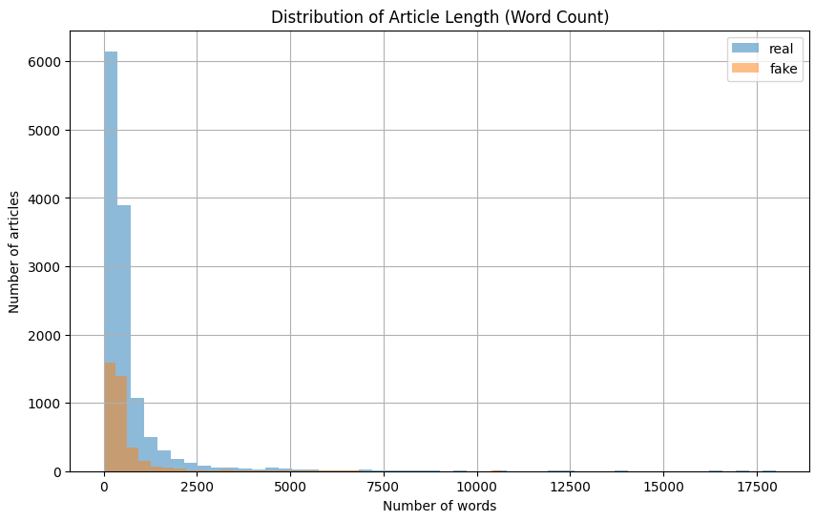
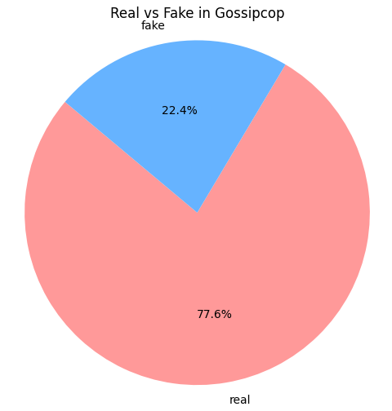
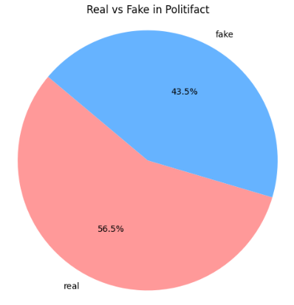
Text Visualization
03

Slide 8

Text Cleaning
Converted all text to lowercase.
Removed links like http://example.com.
Removed punctuation and numbers.
Removed extra spaces.
01
02
03
03

Slide 9
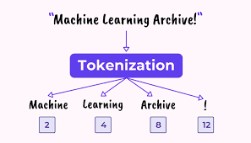
Text Tokenization
Turned words into numbers using a tokenizer.
Used only the top 10,000 most common words.
Replaced unknown words with <OOV>.
Made all sequences the same length (300) by padding.
01
02
03
03

Slide 10
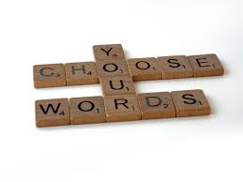
Text Augmentation
Used 30% of the dataset to generate new data.
Randomly removed some words from each sentence.
This helps the model generalize better.and solve class imbalance
01
02
03

Slide 11
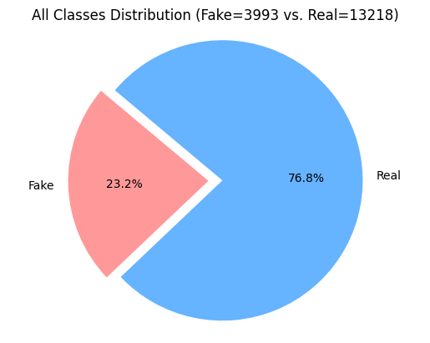
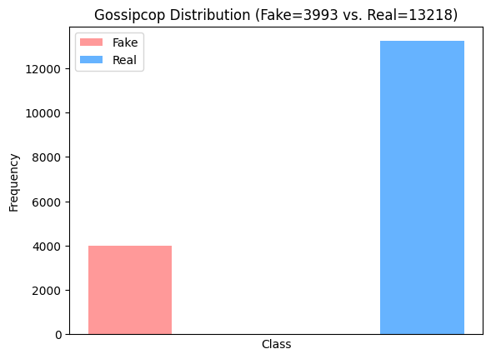
Images Visualization
Real vs Fake Classes
The pie charts and Diagrams illustrate the distribution of fake and real news in two datasets—Gossipcop and Politifact—as well as their combined statistics. In the Gossipcop dataset, real news makes up the majority at 77.4%, while fake news accounts for only 22.6%. In contrast, the Politifact dataset is more balanced, with 41.3% fake and 58.7% real news. When both datasets are combined, real news still dominates at 76.8%. This skew in distribution suggests that any classification model trained on the combined data may be biased toward predicting real news, which highlights the importance of addressing class imbalance during model development.
07

Slide 12
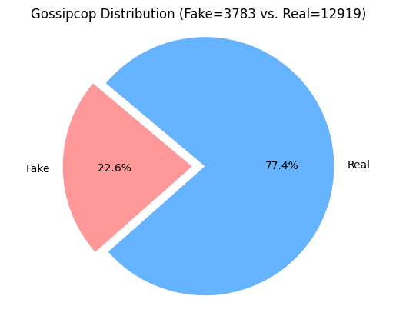
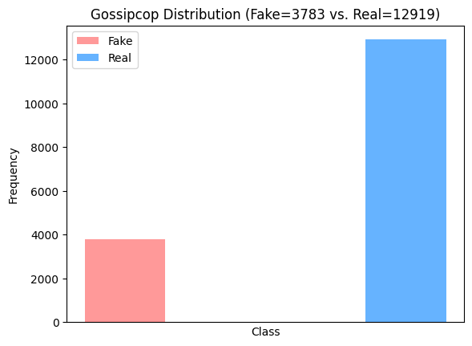
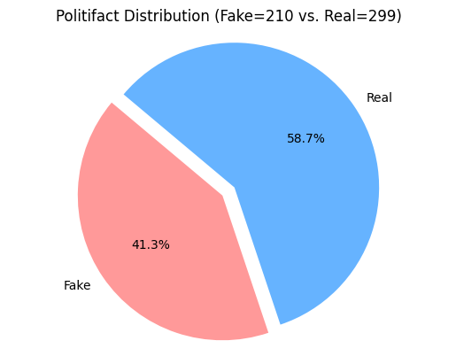
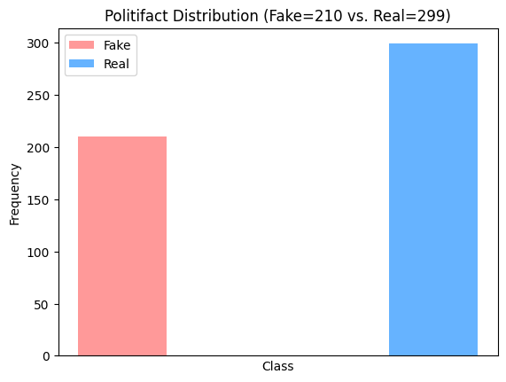
Images Visualization
08

Slide 13
Image Augmentation
Augmented by using the following:
v2.Resize(size=(224, 224))
v2.RandomHorizontalFlip(p=0.5)
v2.ColorJitter(brightness=.5, contrast=.2, saturation=.2)
v2.RandomAdjustSharpness(sharpness_factor=.2)
v2.ToImage()
03

Slide 14
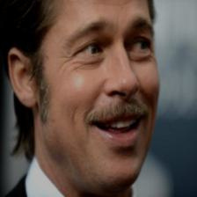
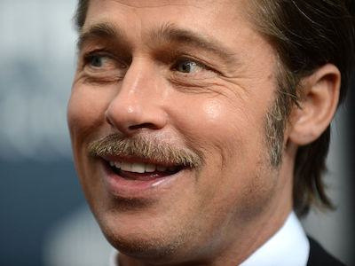
Image Augmentation
Example from GossipCop Fake
03

Slide 15
Problems & Solutions
We didn’t know the source file (Gossip/Polti-ID)
We couldn’t link images with text
No Error Tracking
Developed a code that enable us to save Json files directly to dataset
Made two new columns: “ID” and “Images_Error”
The same code does downloading images into new directories
03

Slide 16
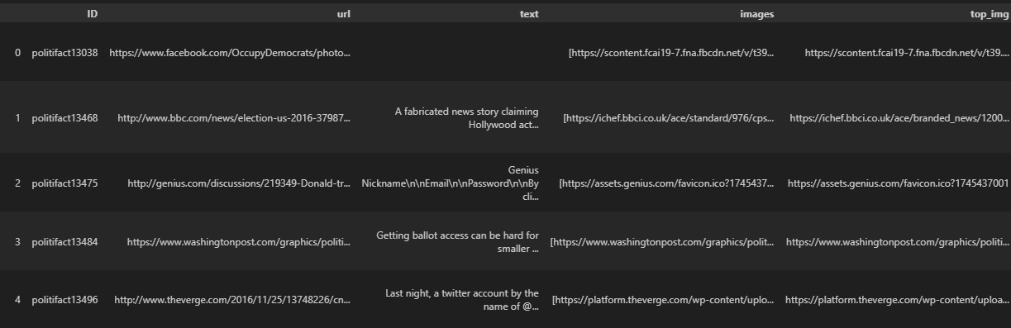
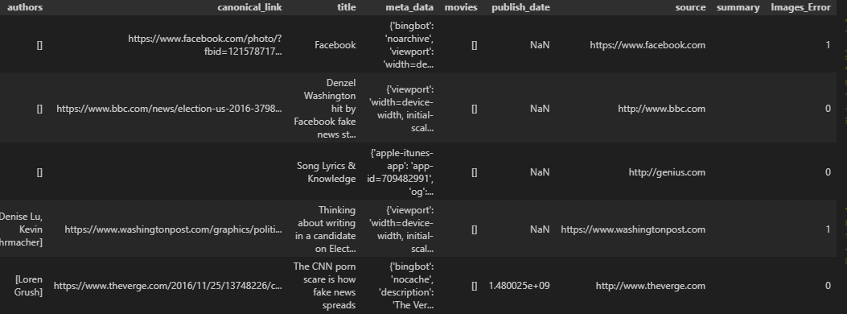
Finalized Dataset
03

Slide 17
Methodolgy
Steps taken:
1- Preprocessing (Done in phase1)
2- Implementing models (2 Images + 2 text)
3- Combining models (Late and Early Fusions)
4- use of vlm (clip+bert)
08

Slide 18
Methodolgy
Models:
LSTM with MobileNet
why?
BERT with EffiecientNet
why?
BERT with CLIP
why?
Fusion Models:
Late Fusion
LSTM with MobileNet
Early Fusion
BERT with EffiecientNet
08

Slide 19
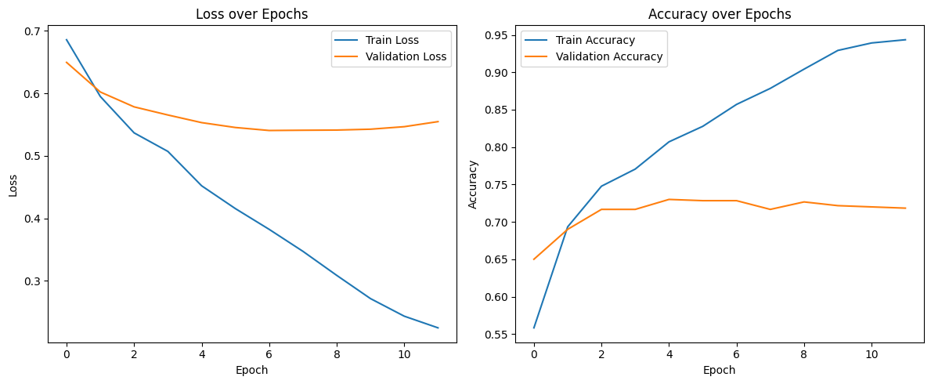
Comparison and Results
Early Fusion
08

Slide 20
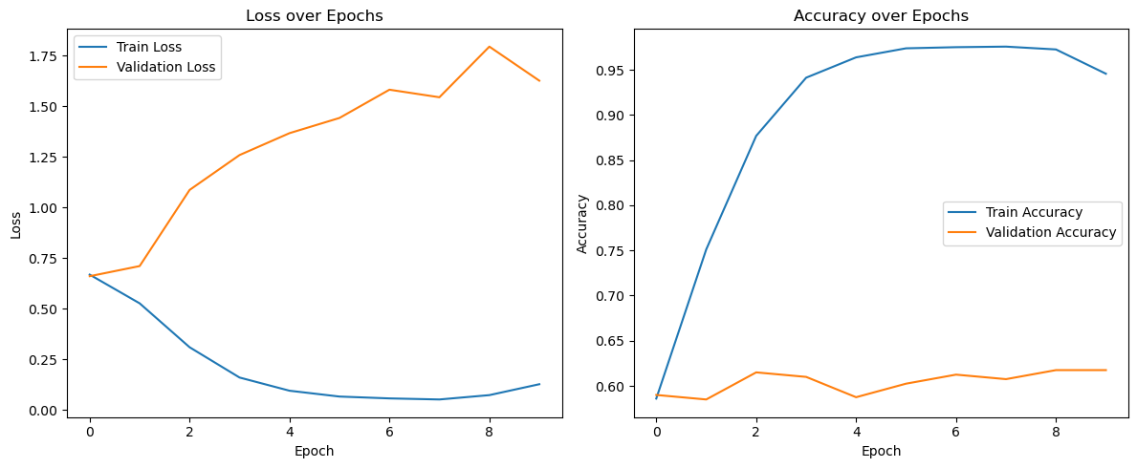
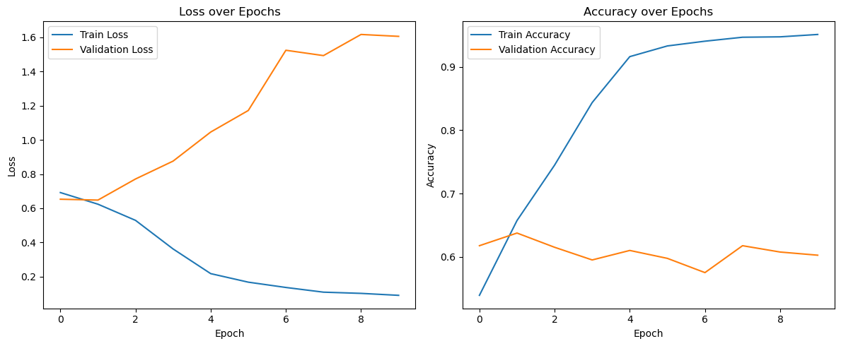
Comparison and Results
tried solving overfitting
Late Fusion
08

Slide 21
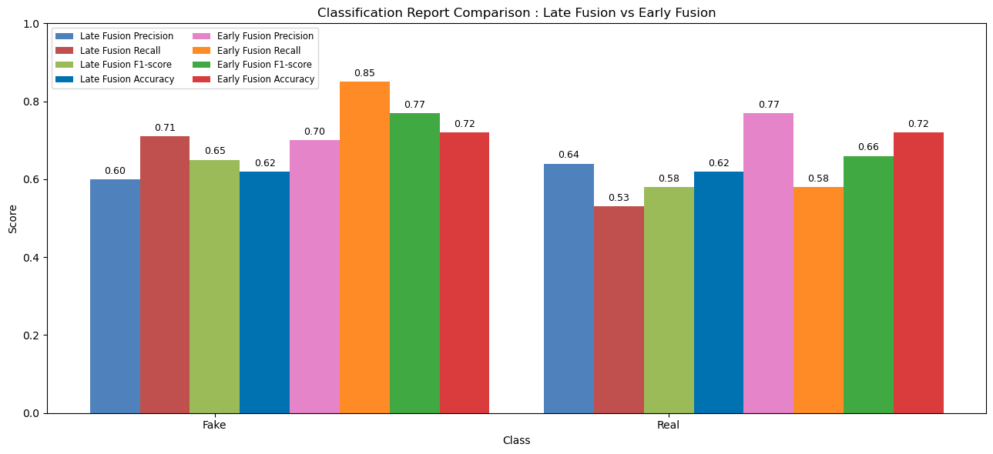
Classification Reports
08

Slide 22
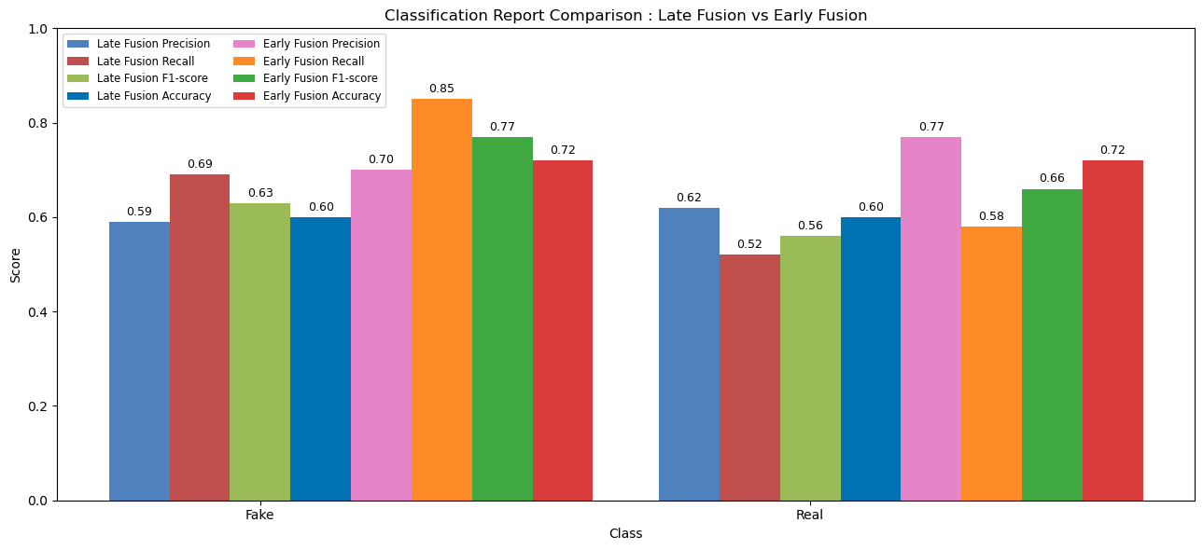
Classification Reports
08

Slide 23



